Slide 1



Credit Worthiness Prediction
Team: IPBA 11 - Group E
Domain: BFSI
Mentored by:
Ms. Ashna Grover
Business Consultant, Accenture

Slide 2
Team Members
Akansha Sinha
Brajesh Kumar Verma
Hrishikesh Bapat
Maneet Singh Saluja
Preeti Asrani
Pritesh Agarwal
Saibal Ghosh
Tanu Khanna Sood

Slide 3
Agenda
Business Problem & Objectives
Data Summary & Data Merging
EDA & ML Methodology
Challenges & Limitations
Learnings & Future scope
Conclusions

Slide 4
Business Problem
A financial institute wants to analyze their customer’s eligibility before issuing them a credit card in order to reduce the Credit Risk.
We are building a “Predictive Model to help financial institutions to derive whether an Applicant is eligible or non-eligible for their product – credit card”.
Credit cards or loans are the core business of banks. The main profit comes directly from the loan's interest. The loan companies grant a loan after an intensive verification and validation process. However, they still don't have an assurance that the applicant can repay the loan with no difficulties.

Slide 5
Objectives
1
The project team uses personal information submitted by applicants and their past credit history.
2
The team recommends the best model after exhaustive EDA, data pre-processing and showcasing a comparison of various models they have built.
The intent of this project is to develop a credit card eligibility model with high prediction accuracy. Hence the project’s success will be evaluated on High Accuracy and a High Capture Rate of the final model. By this, the Financial Institutions can decide whether to issue a credit card to the applicant or not.
3

Slide 6



Model Journey
Prediction Provide insights for the eligibility of an applicant
Tool used :
1
Output
Data drilling &
ML Models
Performing a comparison of various machine learning models
Python
Tableau
Excel
1
Model
EDA & Data Pre-processing Analyzing, cleaning & organizing the data in structured
1
Data Collection
Gathered datasets from Kaggle
EDA
1
Read

Slide 7
Data Summary
Application Records
Applicants personal & demographics details
Credit Records
Credit history of the existing clients
Total records – 438557 rows X 18 columns
ID – Unique Id of the row
Categorical Variables - CODE_GENDER ; FLAG_OWN_CAR ; FLAG_OWN_REALTY ; NAME_HOUSING_TYPE ;
CNT_CHILDREN ; CNT_FAM_MENBERS;
NAME_INCOME_TYPE ; NAME_EDUCATION_TYPE ;
NAME_FAMILY_STATUS ; FLAG_MOBILE ;
FLAG_WORK_PHONE ; FLAG_PHONE ;
FLAG_EMAIL ; OCCUPATION_TYPE
Continuous Variables - AMT_INCOME_TOTAL ; DAYS_BIRTH ; DAYS_EMPLOYED
Total records – 1048575 rows X 3 columns
ID – Unique Id
MONTHS_BALANCE - The month of the extracted data is the starting point, backwards, 0 is the current month, -1 is the previous month, and so on
STATUS - 0: 1-29 days past due 1: 30-59 days past due 2: 60-89 days overdue 3: 90-119 days overdue 4: 120-149 days overdue 5: Overdue or bad debts, write-offs for more than 150 days C: paid off that month X: No loan for the month

Slide 8
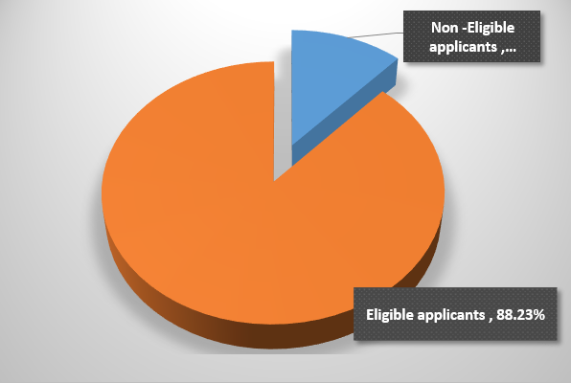
Data Merging
Two datasets are merged using an inner join.
Imbalance ratio is 7.5
Application record dataset has multiple duplicate rows, values for all the IV’s are the same across rows except ID. We have kept duplicate records in this approach.
Occupation_type has 134203 missing values which is 30.60%. As it is an important variable, we have imputed it by creating two categories – retired & others.
Application
Record
Credit record dataset is grouped with the ‘id’ variable by taking the maximum value of the status variable against the applicant's id.
Status is dependent variable, has changed to the binary output by substituting any value that is equal to 2 or above by '1's and below 2 by ‘0’s.
'0's means Eligible (including customers that are 0-29 days past due date) and '1's means Non-eligible.
Credit
Record

Slide 9
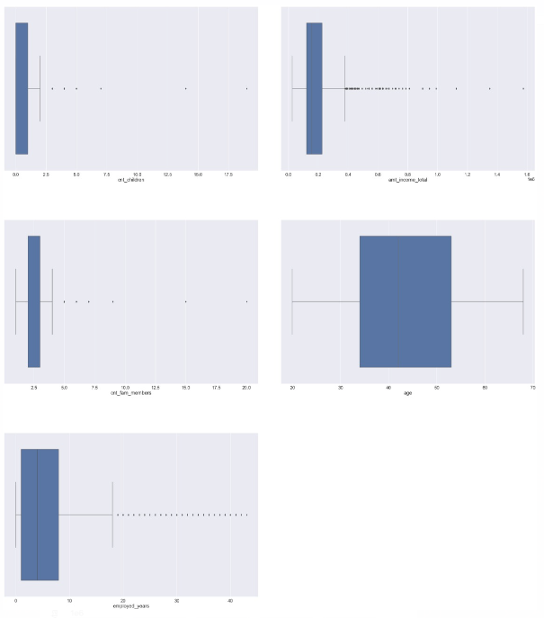
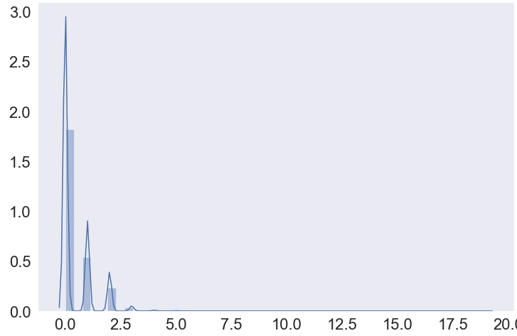
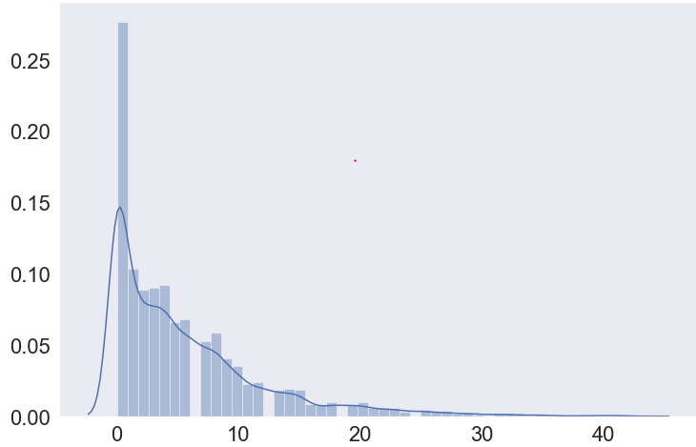
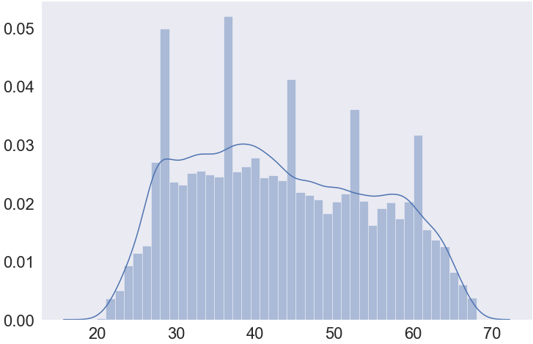
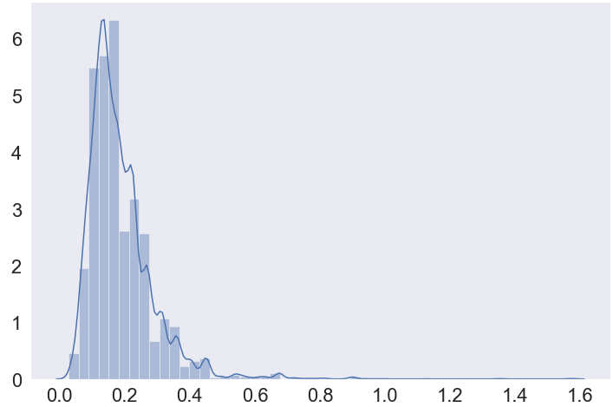
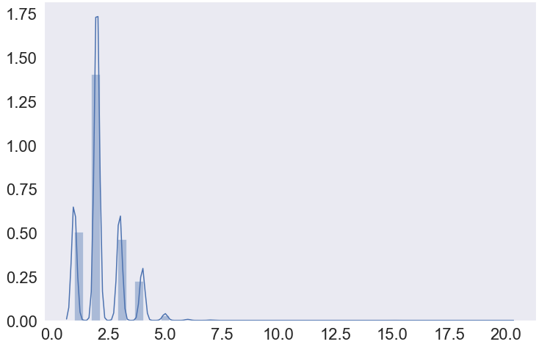
Exploratory Data Analysis
cnt children
amt income
cnt children
employment years
age
amt income
fam members
age
Box-plots are for finding outliers in continuous variables.
Histograms are to graphical summarize, the distribution of continuous variables.
Team had perform the univariate, bivariate & multivariate analysis across different variables. The graphics are available in code file.
fam members
employment years

Slide 10
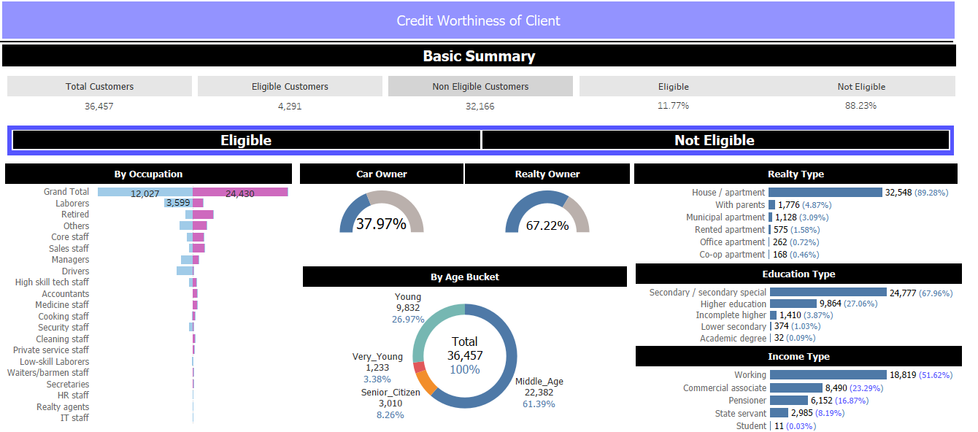
Variables Data Visualization
We have developed a Visualization in Tableau using our cleaned and final dataset output. This can help decision makers to understand the numbers of eligible customers by all the dependent parameters that have contributed for their eligibility.
We have published this view in Tableau public as well below is the link for same:
Link to open Tableau Dashboard

Slide 11
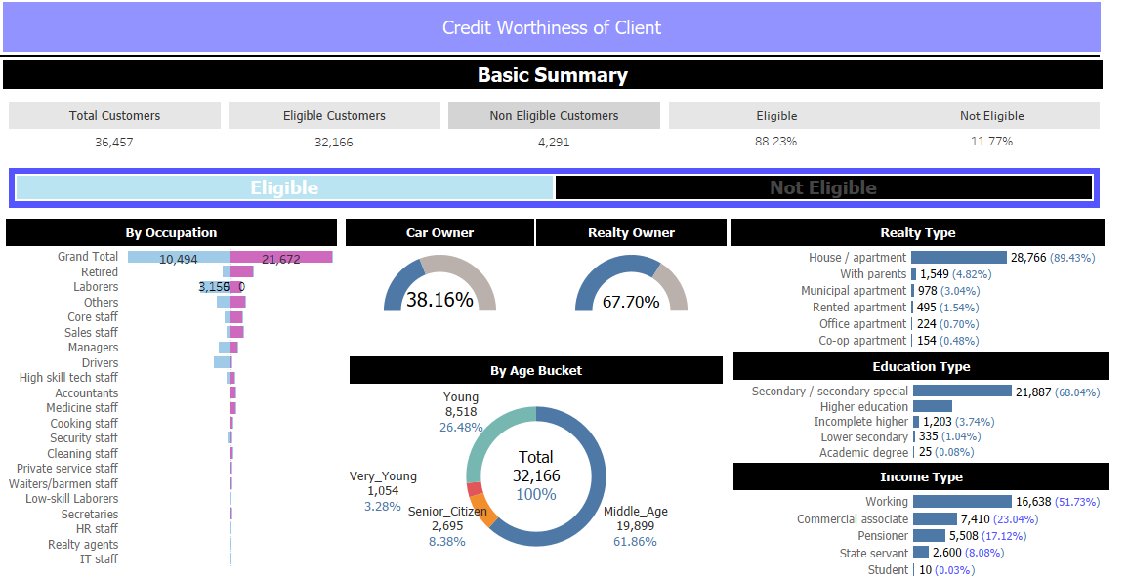
Variables Data Visualization
Developed view in an interactive piece showing dynamic values that are filtering each other.
All the charts on dashboard are working as a filter on each other. For example in below screenshot. We have selected the eligible button in
For example:
We can see there are 36457 total customers.
When we select Eligible button as highlighted we can see there are 32166 customers that eligible out of which 10494 are male and 2758 are female out of which 38.16% Eligible customers own a car and 67.70% Customers own real estate further we can see the break down by age, realty type, education type, income type and etc.
All the charts work as a filter we can select each dimension in chart and it will work as filter.

Slide 12
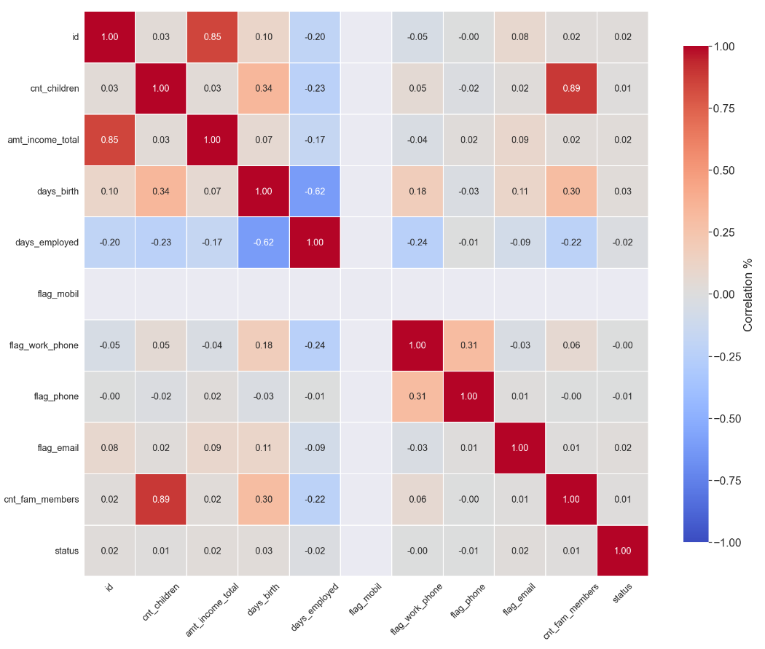
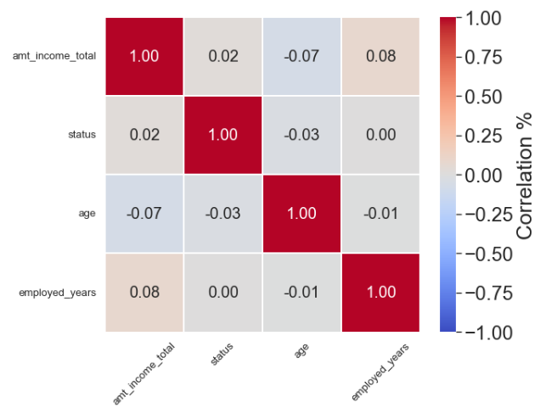
Correlation – Matrix
Merged_data
Cleaned_data

Slide 13
Variables Selection
Status
Dependent Variable
Eligible Applicant (0)
Non-eligible Applicant (1)
ID – unique identifier will lead to overfitting
flag_mobil - as all the applicant has the mobile
cnt_children - VIF is higher than 10
Dropped Variables
code_gender ✓ name_housing_type
flag_own_car ✓ flag_work_phone
flag_own_realty ✓ occupation_type
flag_phone ✓ name_income_type
flag_email ✓ name_family_status
cnt_fam_members_bkt
name_education_type
Independent Variables

Slide 14
Key Variables
Age
Employed years
Count fam members
Amount income
Occupation
Type
Family status
Days of birth column has been transformed to understand the age of applicant.
Mid age people are the most frequent applicants for credit card with most difficulty in pay it back.
Senior Citizen and Young people below the age of 18 face lesser difficulties.
Applicant's income is a vital component in deciding the eligibility with a mean of 1.8 Lakhs.
Income has been bucketed into 5 categories with majority of the population falling under Medium bucket
Work experience is another vital aspect to understand person capacity to payback loan.
Retired people are also considered in this column and replaced to 0.
With higher years of Employment the rejection rate is decreased.
Applicants with more than 30 years of service are most likely not to be rejected.
Applicant's occupational details are described in this column.
There are 30% null values and in order to justify this a new category called "Retired" has been formed and rest are filled by NA.
Low skill labourers had faced the maximum rejection rate of about 19% with Private service staff being the most eligible candidates.
No of Family members can be vital to understand dependencies of the applicant.
People having Family members greater than 4 have been treated as outliers.
The rejection rate of people with family members more than 4 has gone up to 67%.
Marital status is represented by this column.
69% of our applicants are married.
13% is the maximum rejection rate and is faced by Single applicants followed by Civil marriage.

Slide 15
Application of Machine Learning Models
Random Forest Classifier
Gradient Boosting Classifier
XG Boost
Classifier
06
Decision Tree
Classifier
05
K Neighbors Classifier
04
Logistic Regression
03
02
01
Model selected based on performance

Slide 16
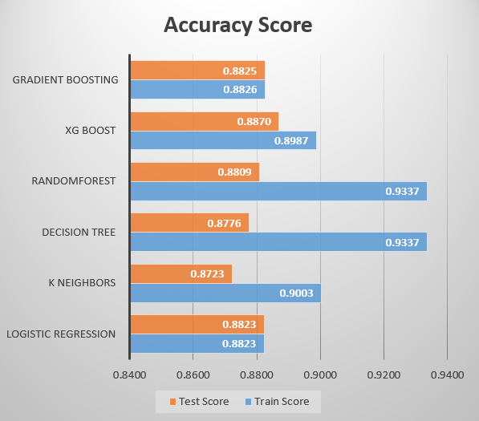
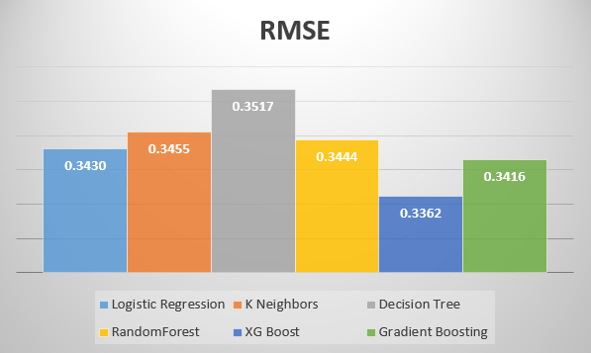
Accuracy & RMSE
XGBoost standout among all the models when comparing accuracy score and RMSE
accuracy score of train data – 89.87% and test data - 88.70%
RMSE - 0.3362

Slide 17
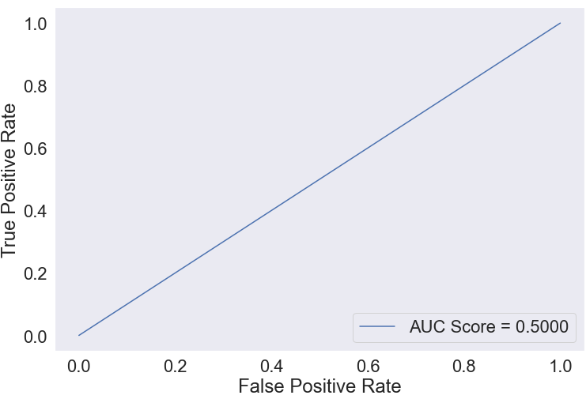
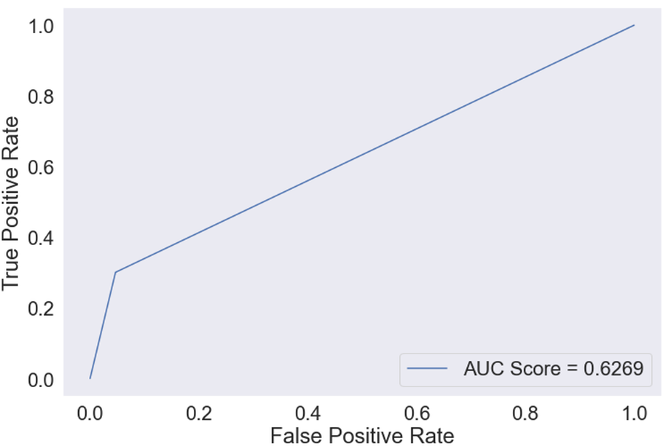
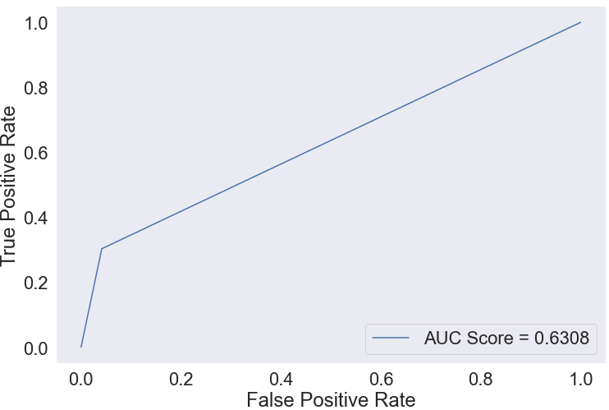
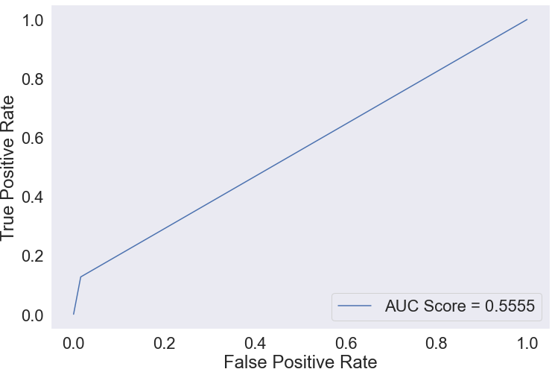
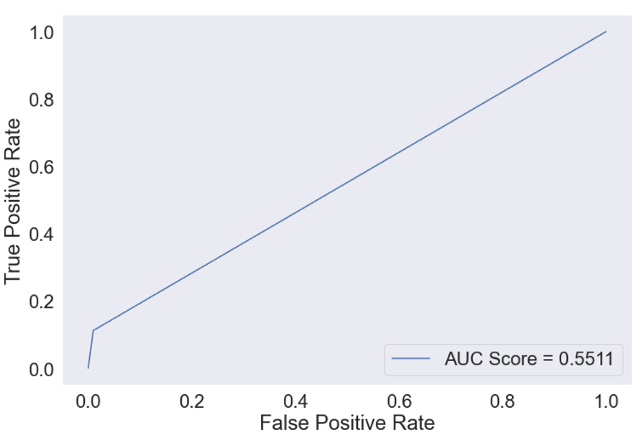

ROC Curve
Logistic Regression
Decision Tree Classifier
Random Forest Classifier
Gradient Boosting Classifier
XG Boost Classifier
KNeighbors Classifier

Slide 18
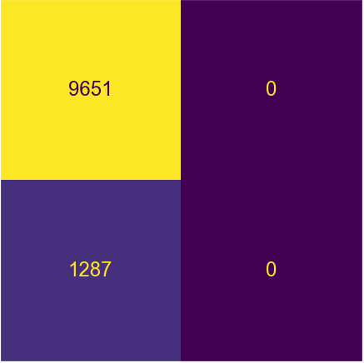
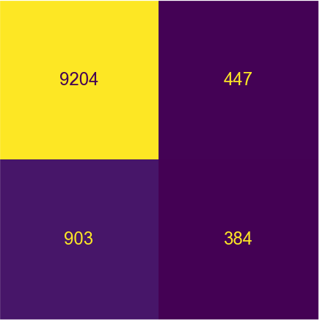
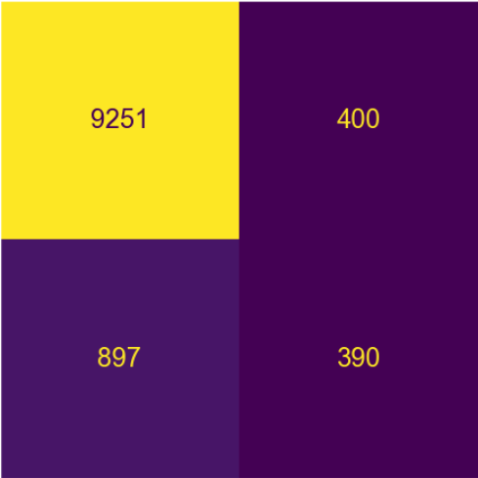
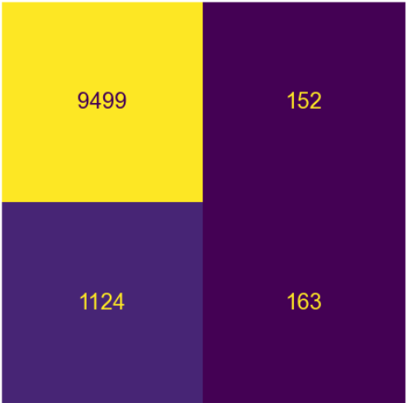
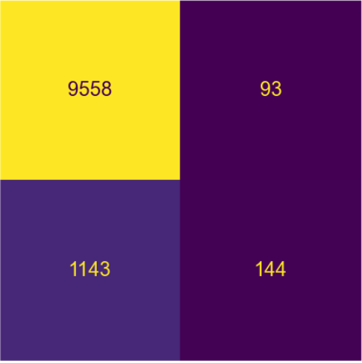
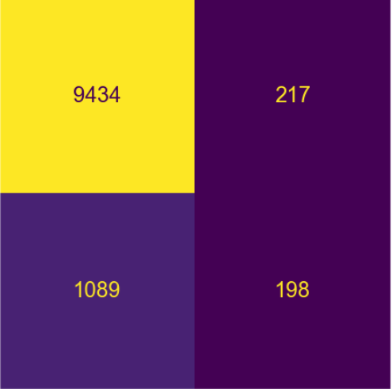
Confusion Matrix
Logistic Regression
Decision Tree Classifier
Random Forest Classifier
Actual Labels
Non-eligible(1) Eligible(0)
Actual Labels
Non-eligible(1) Eligible(0)
Actual Labels
Non-eligible(1) Eligible(0)
Eligible(0) Non-eligible(1)
Prediction Labels
Eligible(0) Non-eligible(1)
Prediction Labels
Eligible(0) Non-eligible(1)
Prediction Labels
Gradient Boosting Classifier
XG Boost Classifier
K Neighbors Classifier
Actual Labels
Non-eligible(1) Eligible(0)
Actual Labels
Non-eligible(1) Eligible(0)
Actual Labels
Non-eligible(1) Eligible(0)
Eligible(0) Non-eligible(1)
Prediction Labels
Eligible(0) Non-eligible(1)
Prediction Labels
Eligible(0) Non-eligible(1)
Prediction Labels

Slide 19
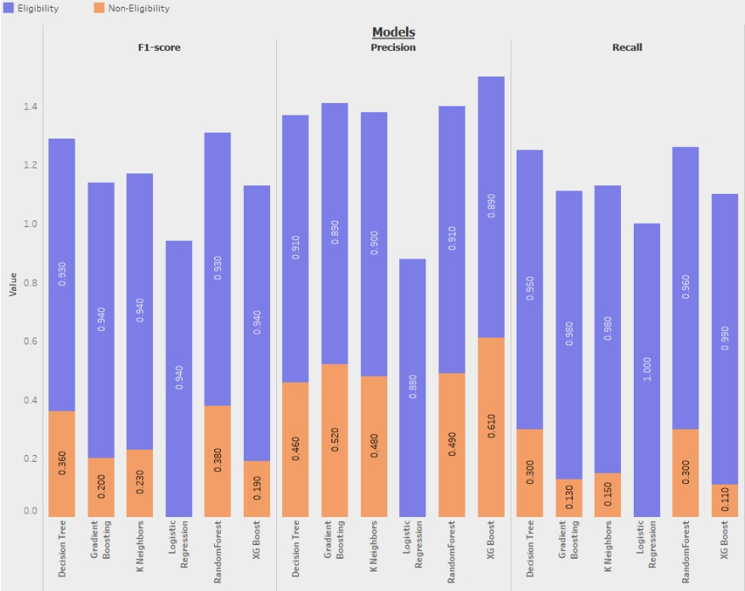
Classification Report
Selected Model
As per accuracy, XGBoost was better classification model with 88.7%.
We also found out that logistic regression was worst model as per the performance(with recall as 0) although accuracy was 88.23%
On comparing other models, as per the performance matrix (like ROC curve & AUC Score, Confusion Matrix and classification report such as recall, precision and F1 score), Random Forest Classifier gave better performance

Slide 20
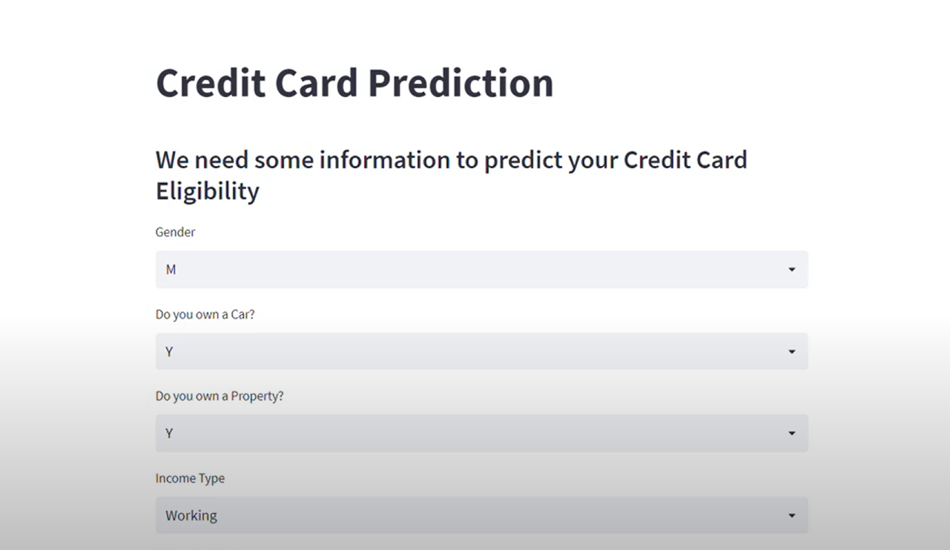
Machine Learning Model Deployment with Streamlit Web-App
Link to video of Machine Learning Deployment with Streamlit Web-App

Slide 21
Challenges, Limitations, Learning & Future scope
CLLF
Challenges & Limitations
Duplicate data in most of the application records
Null values in occupation type field is approximately 31%
Multiple error values in employed years field
Mean of continuous variable for eligible and not eligible applicants were almost similar
Learning
Data availability should be to the latest
To predict accurately it's preferred to have a larger dataset and sample size
Variables with VIF > 5 are usually dropped but we can still consider them based on the business need and its significance
Future scope
In present scenario we have used worst instance of credit history of the applicant as eligibility criteria. In future we can consider calculating credit score based on payment history to decide his eligibility for the product.
Hyper-parameter tuning to improve the model performance
Implementing Neural Network Models to check if it fits best
Including additional features and test as it may improve the model performance

Slide 22
Conclusion
Credit cards are a common risk control method in the financial industry. We have used personal information / data submitted by applicants to predict the probability of future defaults and credit card borrowings.
We have used supervised classification algorithms such as Logistic Regression, Decision Tree, Random Forest, XG Boost, Gradient Boosting, and K Neighbors. After modelling data with each Algo., we have chosen Random Forest Classifier as it performed the best based on evaluation metrics.
The model can help in decision making by taking input features and by returning the genuineness of the customer based on past delinquency status and personal information.

Slide 23

Hyperlinks
Code zip file:
Link to open Tableau Dashboard
Link to BYOP Capstone Project files on Google Drive
Link to video of Machine Learning Deployment with Streamlit Web-App

Slide 24
Thank You
From:
Team : IPBA 11 - Group E

